Slide 1
A model for study: Ultramafic ecosystems of Mount Kinabalu
Antony van der Ent and Andrew Fletcher

Slide 2
Introduction

Slide 3
Ultramafic outcrops
Discrete ultramafic outcrops (‘serpentine ‘) are patchily distributed on every continent with the world’s largest outcrops in Indonesia, the Philippines and Malaysia.
Ultramafic rocks are composed of mafic minerals (high magnesium, iron, nickel, chromium and cobalt) and found in large tectonic masses, which are fragments of the upper mantle obducted in continental margins.
Ultramafics are like ‘geochemical islands’ in a ‘sea of normal soils’.

Slide 4
Ultramafic outcrops
Ultramafic substrates are extreme environments because plants growing in these ecosystems must be able to cope with a number of conditions that are normally adverse to plant growth, such as phytotoxic nickel, very high magnesium and extremely low nutrient concentrations.
Ultramafics are essentially toxic and harsh for plants.

Slide 5
Ultramafic outcrops
Characteristics common among ultramafic ecosystems (Whittaker 1954) :
(a) Low stature and biomass production;
(b) High levels of endemism;
(c) Distinct vegetation composition and structure compared
to surrounding non-ultramafic areas.
Plants growing on ultramafics are distinct from the surrounding area

Slide 6
Ultramafic outcrops
As extreme environments, ultramafics make excellent natural laboratories to address topics in evolution, phylogeography, ecology, physiology, including questions of adaptation, biotic response to climate change, etc.
Some ultramafic areas have been well studied through comparative ecological studies involving long-term plot studies (e.g., on Mount Kinabalu, Sabah, Malaysia) accompanied by environmental monitoring sensors that could potentially be networked.
Ultramafics are the ideal ‘model’ ecosystem for a wide range of scientific inquiry.

Slide 7
Mount kinabalu, sabah, malaysia

Slide 8
Ultramafic flora of Sabah
The flora of Sabah is very rich in plant species, with an estimated 8000 higher plants occurring within the boundaries of this state (Wong 1992).
The ultramafic flora of Sabah has a minimum of 2470 plant species, despite covering only 4.6% of the total land area of the State (Proctor et al. 1988).
Plants growing on ultramafics are distinct from the surrounding area

Slide 9
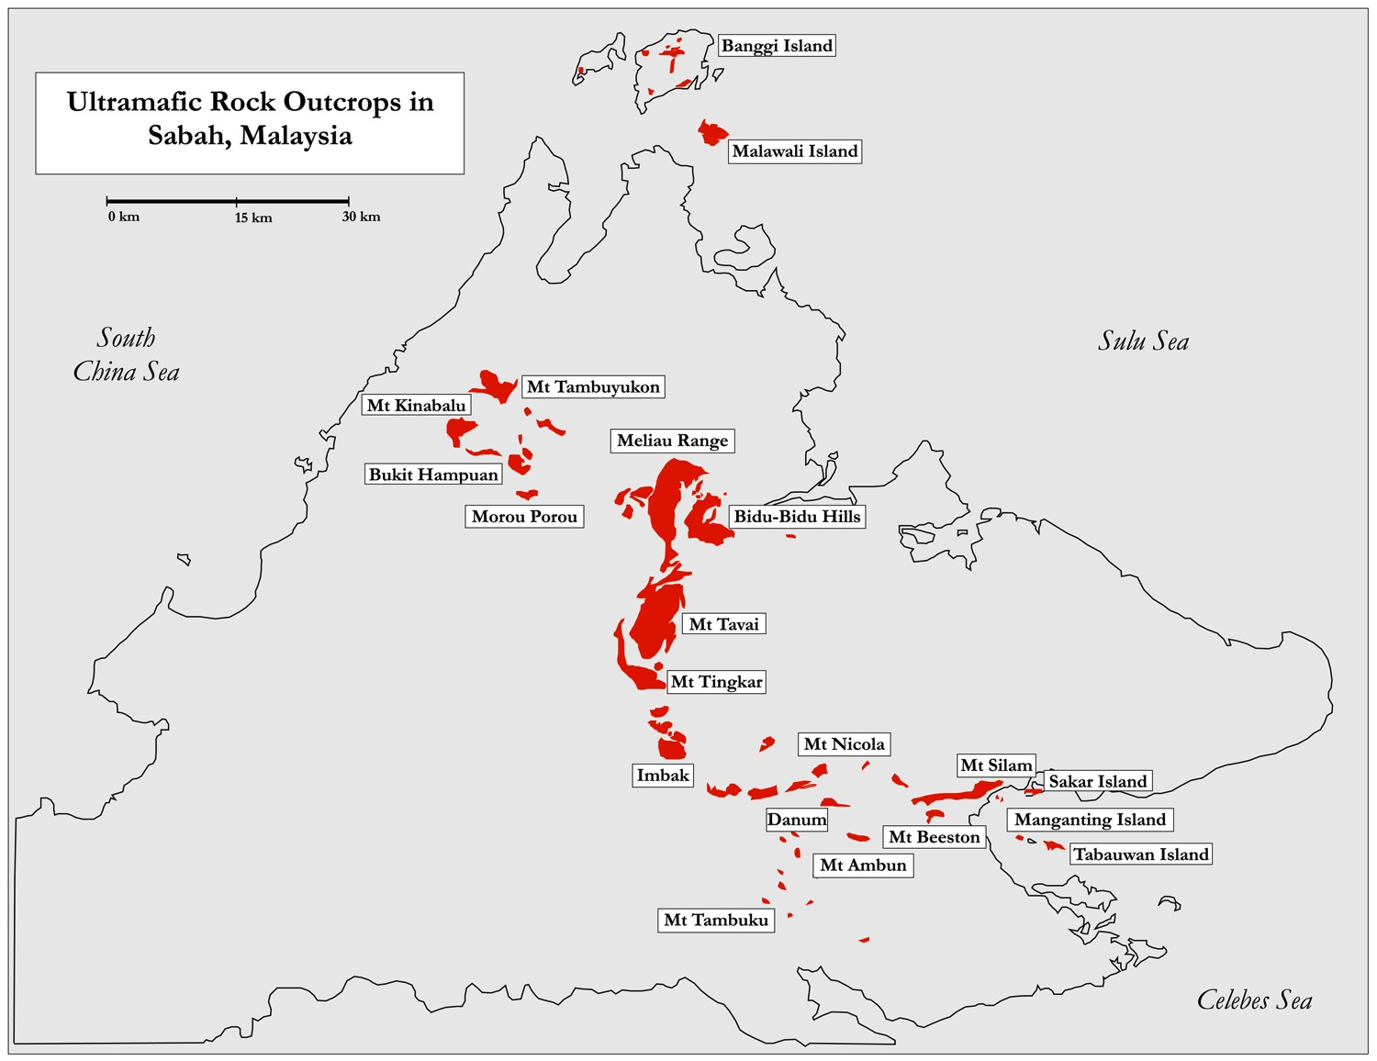

Slide 10
Mount Kinabalu Park
Mount Kinabalu is the most biodiverse place on earth in terms of the number of species-per-area with >5000 species in 200 families and 1000 genera in an area of 1200 km² (Beaman and Beaman, 1990)
Mount Kinabalu contains as much 14% of the total flora of Southeast Asia which has 42.000 species in an area 3.1 million km² (Roos, 1992)
Mount Kinabalu is the most interesting test case in the world because of its extreme biodiversity and complexity.

Slide 11
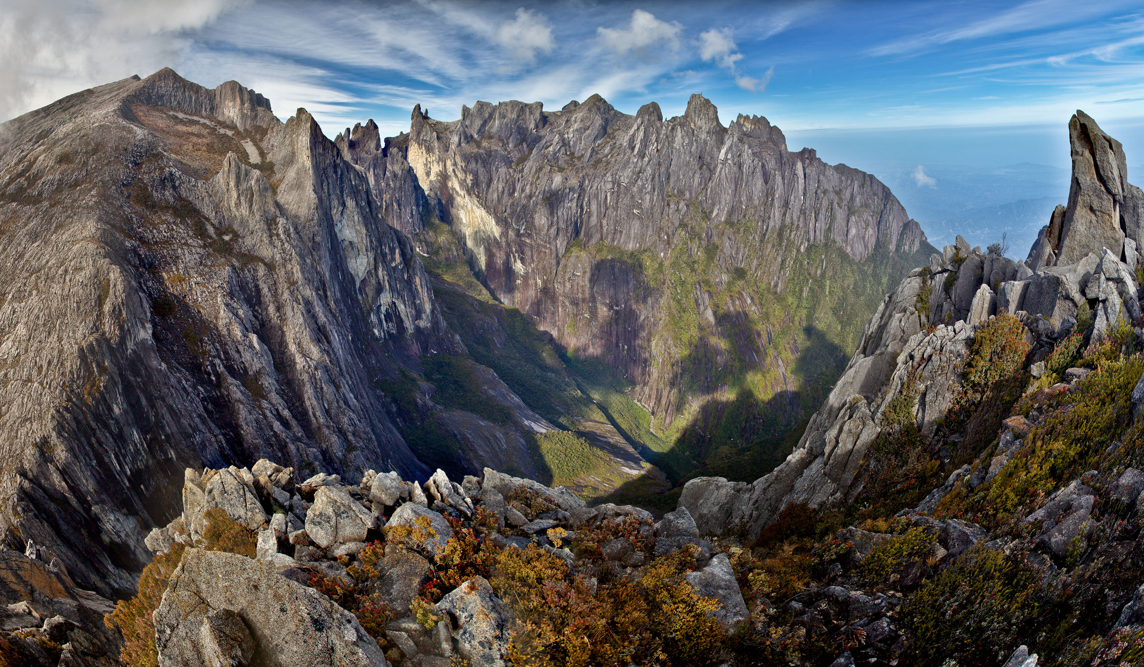

Slide 12
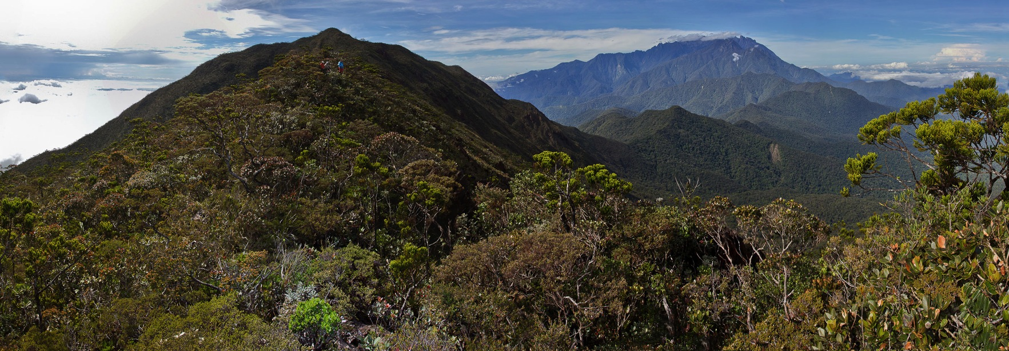
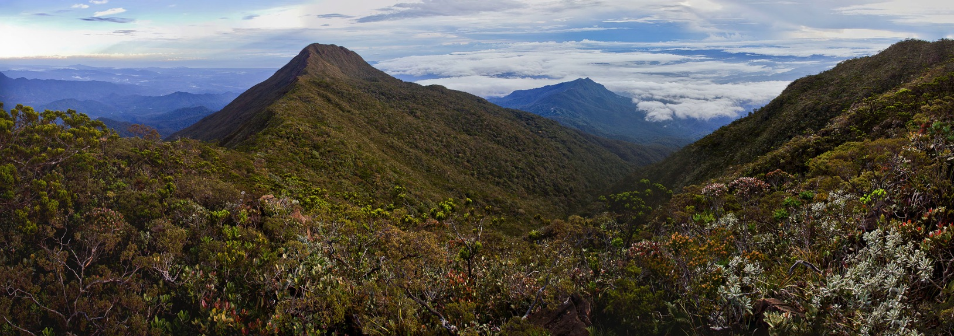
Mount Tambuyukon
Mount Kinabalu
Non-ultramafic
Mount Tambuyukon
Non-ultramafic

Slide 13
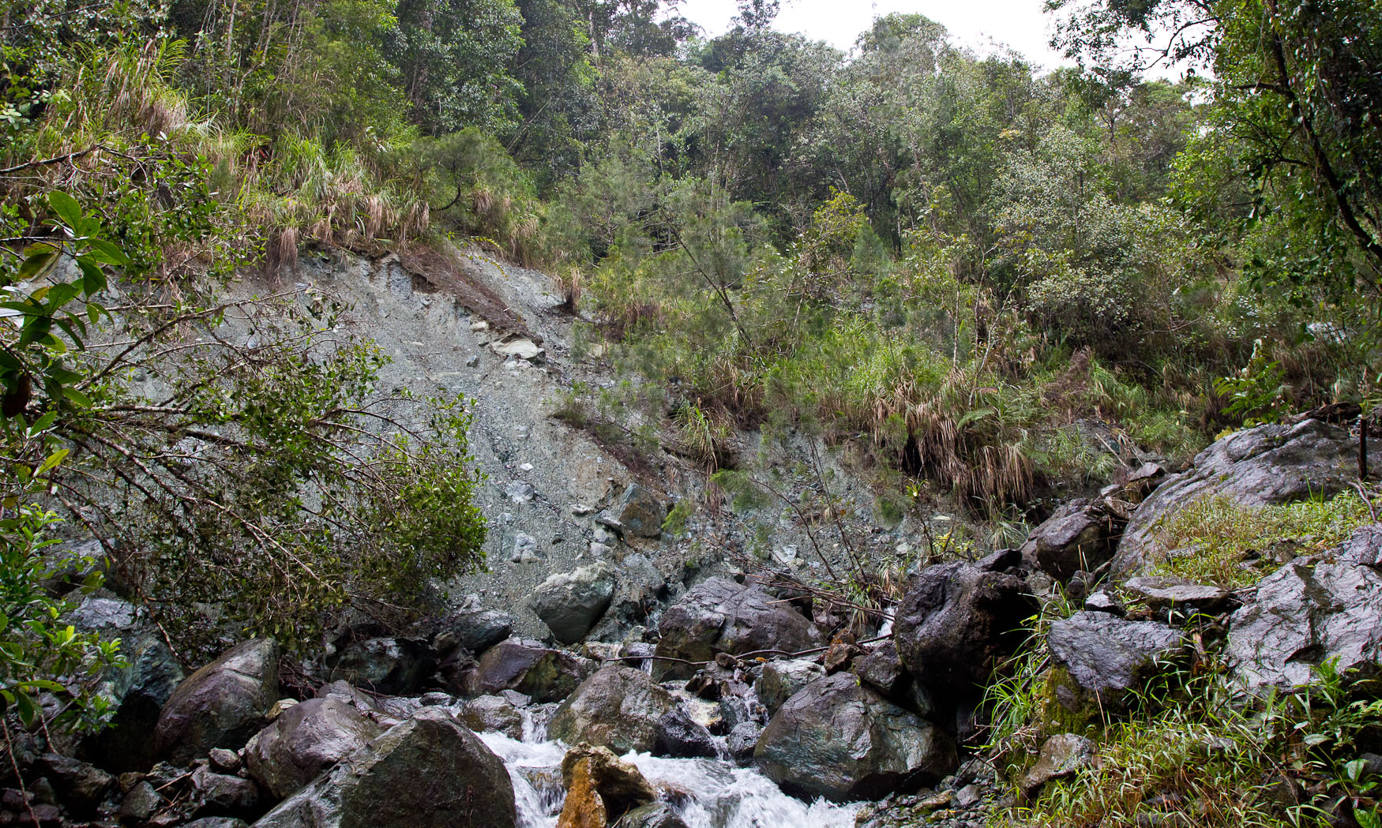
Antony van der Ent

Slide 14
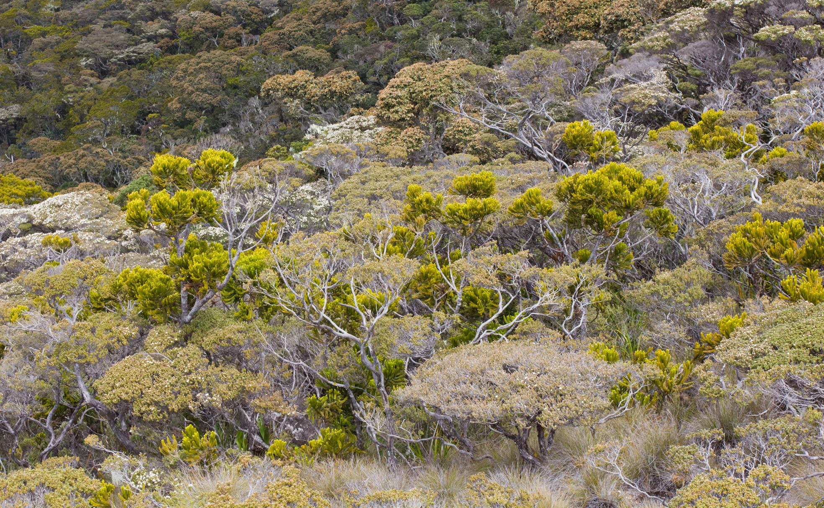
Antony van der Ent

Slide 15
Building an ecosystem model

Slide 16
Building a model for Mount Kinabalu
Building a spatial ‘plant distribution model’ for Mount Kinabalu has the potential to help answer some of the most important questions in tropical ecology, such as:
(1) How important are edaphic forces for plant speciation - endemism in the tropical ecosystems? And, ultimately, why are these ecosystems so species-rich?
(2) What factors (temperature, rainfall, soil chemistry, biogeography) govern plant distribution in rainforests?
(3) Is high-endemism vegetation on extreme soils more sensitive or less sensitive to climate change?

Slide 17
Building a model for Mount Kinabalu
High-resolution hyper/multi-spectral imagery (2-0.25m)
Elevation model (DEM/DSM)
Climate monitoring data
Geological and geochemistry data
Species attributes and distribution database
Spatial plant distribution model

Slide 18
Building a model for Mount Kinabalu
A spatial ‘plant distribution model’ can be derived from spectral and textural analysis of high-resolution imagery, combined with climate, landscape morphological, geological and distribution data.
Multi-species analysis: co-occurrence of species (probability).
Main focus on relationships between climate, soil, and plant distribution.
Potential for wide ranging research on links between distribution, adaptation and evolution.

Slide 19
Data sources & input
Species distribution (70.000+ herbarium vouchers in database)
Satellite imagery (Landsat time-series, IKONOS, acquisition Worldview-2)
Vegetation mapping (existing maps)
Hyperspectral imagery (helicopter-based AISA or UAV)
Spectral and structural attributes of plant species
Elevation models (DSM based on rendering PIX4D + validation)
Geological data (existing maps in ArcGIS)
Geochemistry data (500+ sampling points)
Climate data (15 years of climate monitoring)
Phytochemistry (elemental analysis of 1500+ plants)
Functional data (physiology, gene expression)

Slide 20
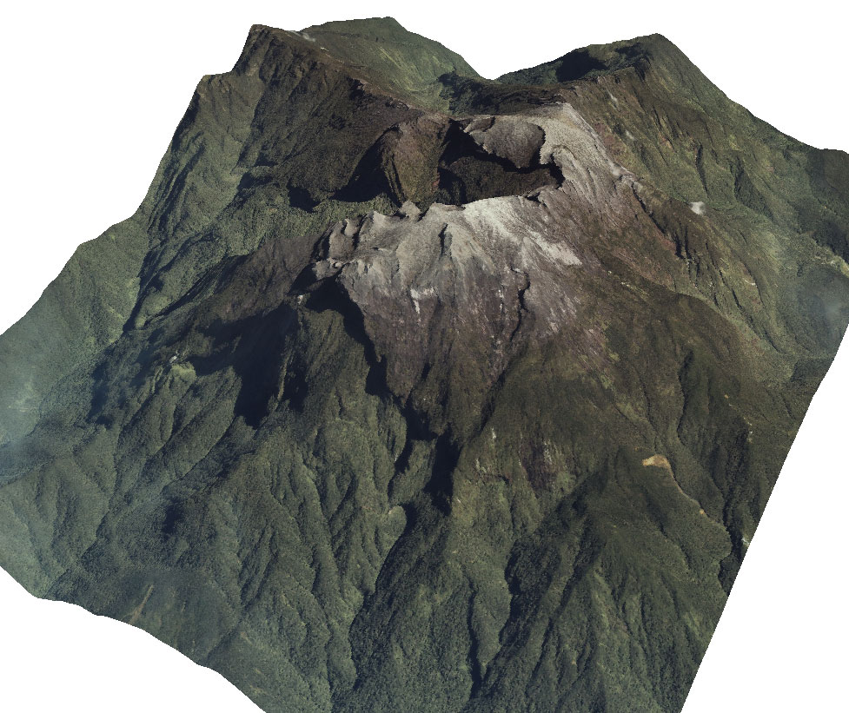

Slide 21
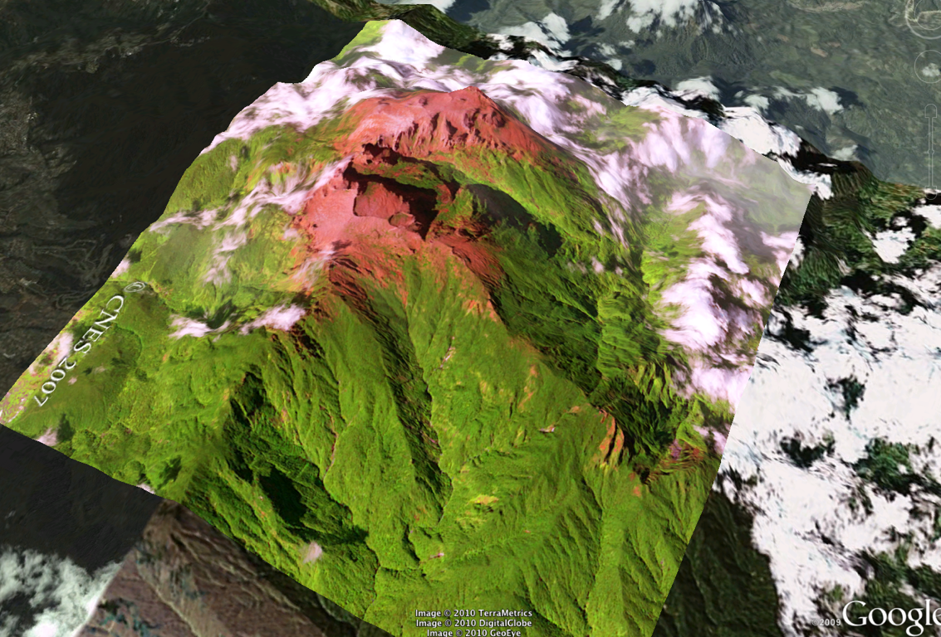

Slide 22
The input for the ecosystem model

Slide 23
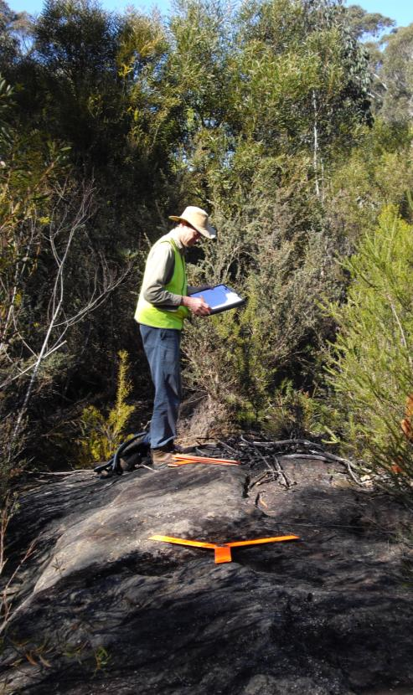
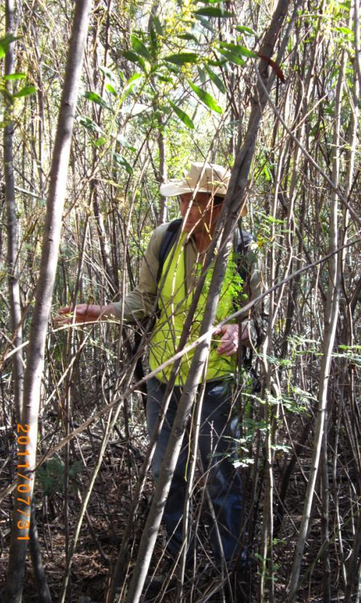
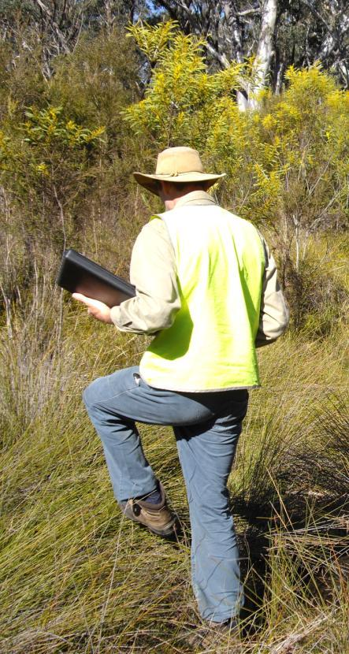
The connection between ground and geospatial dimension

Slide 24
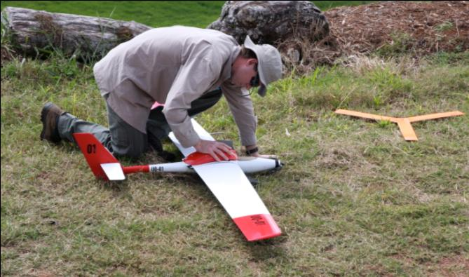
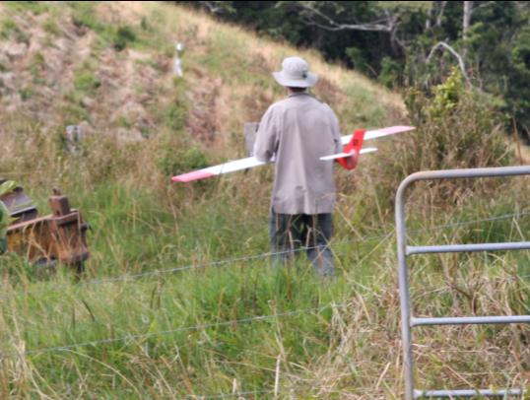
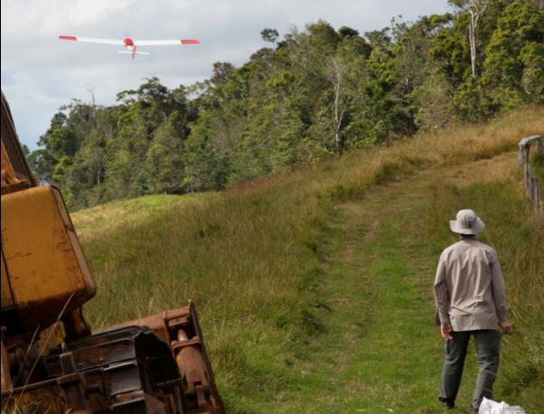
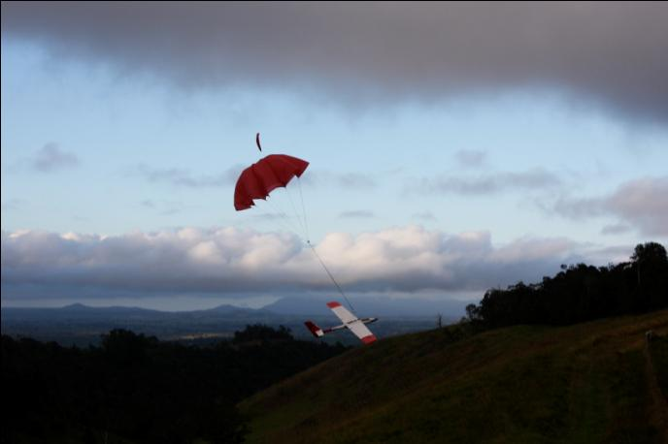
Small Unmanned Aerial Vehicles (UAV’s)

Slide 25
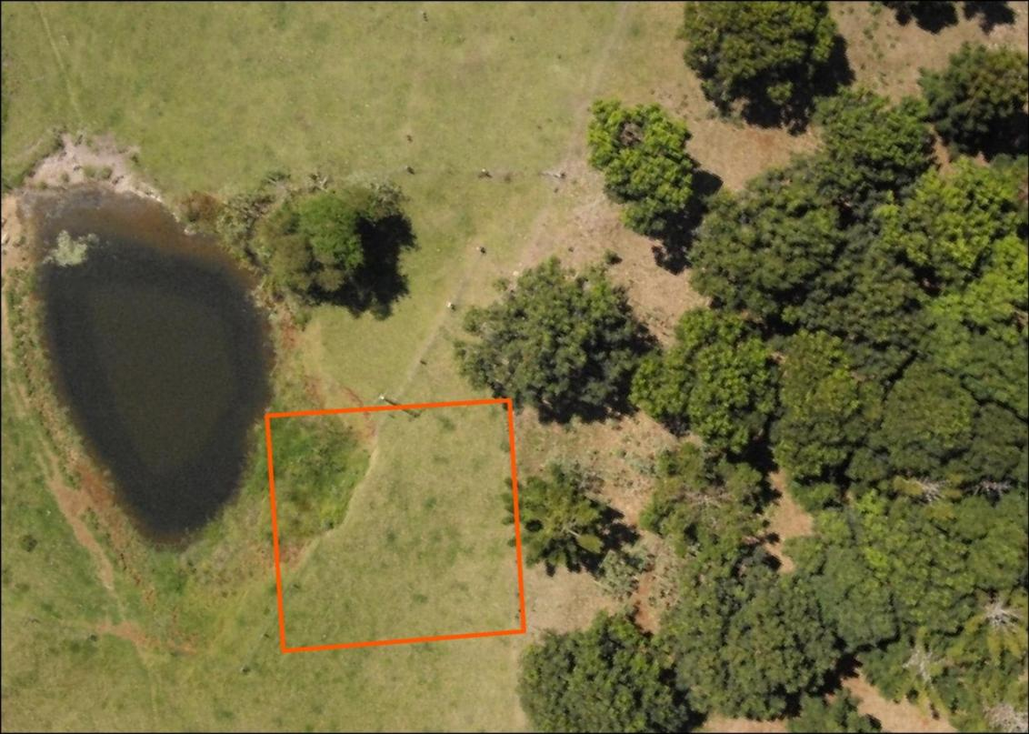

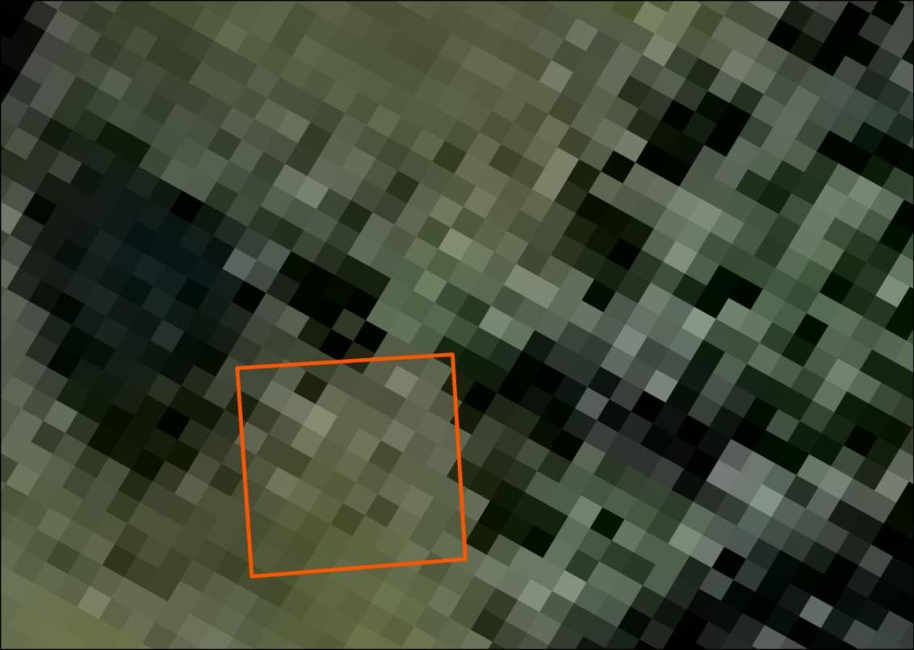
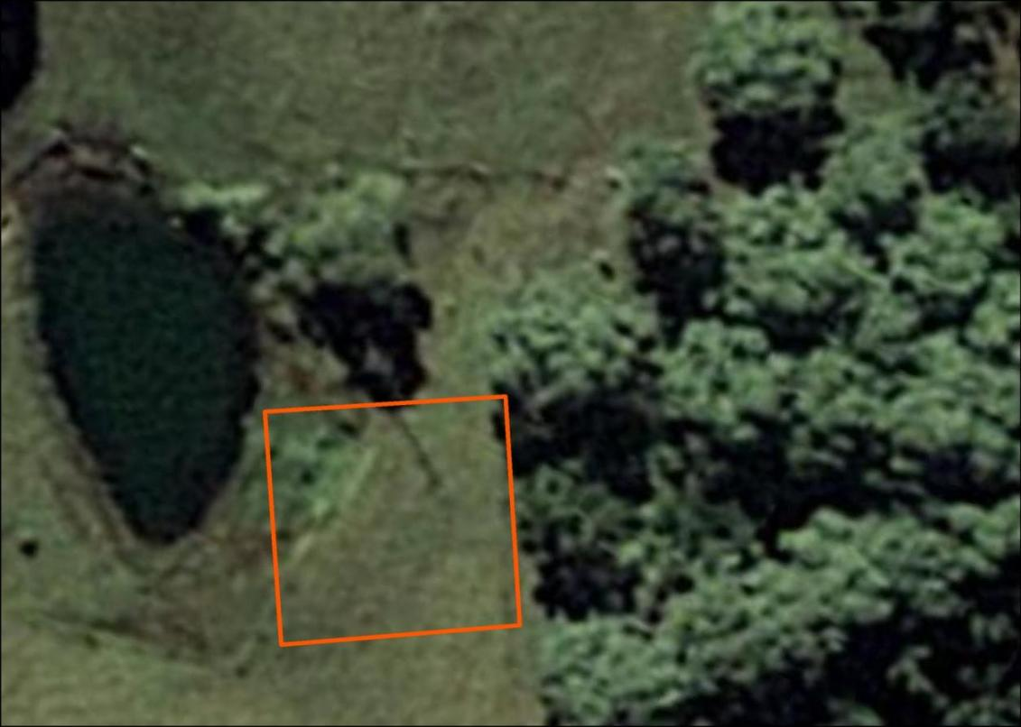
What do ground observers see?
QB2-240cm
Geoeye-50cm
Aerial-20cm
UAV-2.3cm

Slide 26
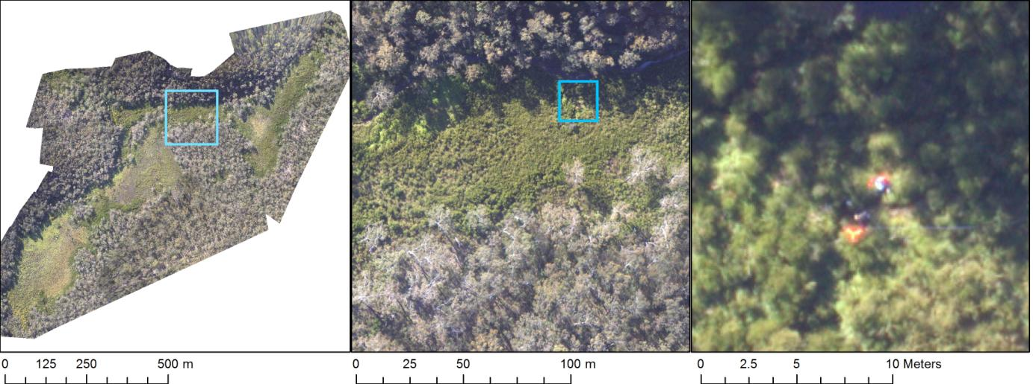
Spatio-temporal resolution

Slide 27
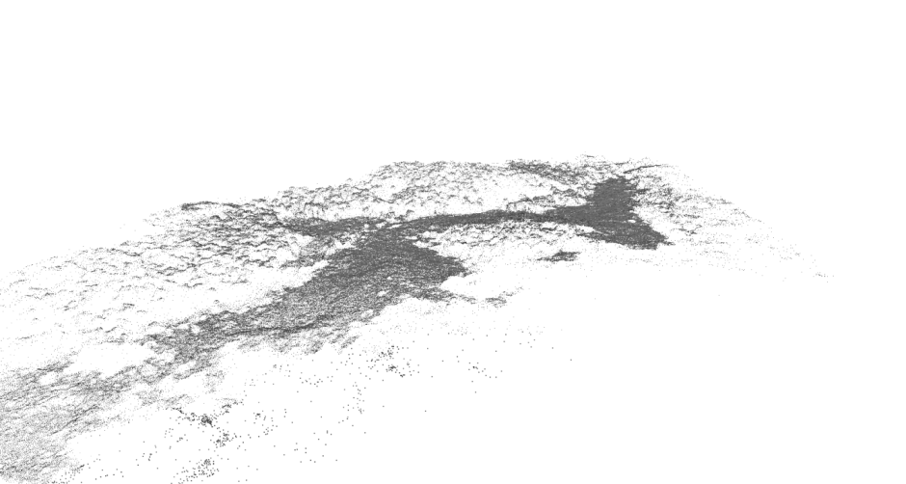
Other possible metrics
3D surface point cloud generated to allow effective orthophoto construction (PIX4D)

Slide 28
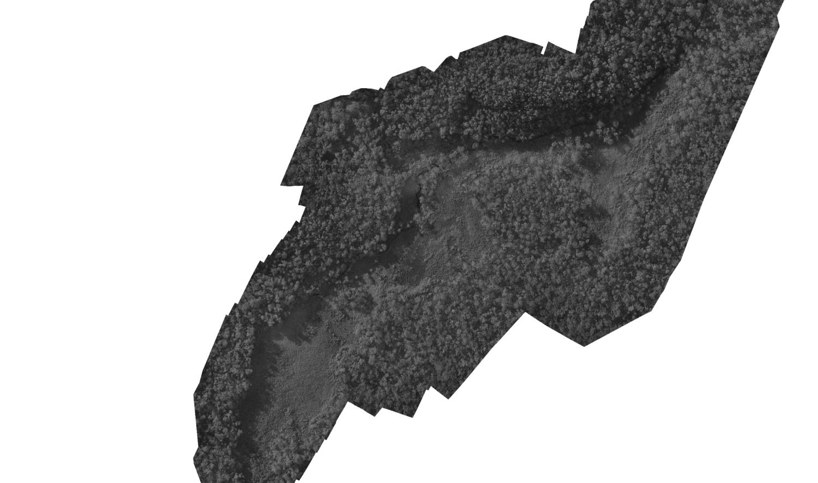
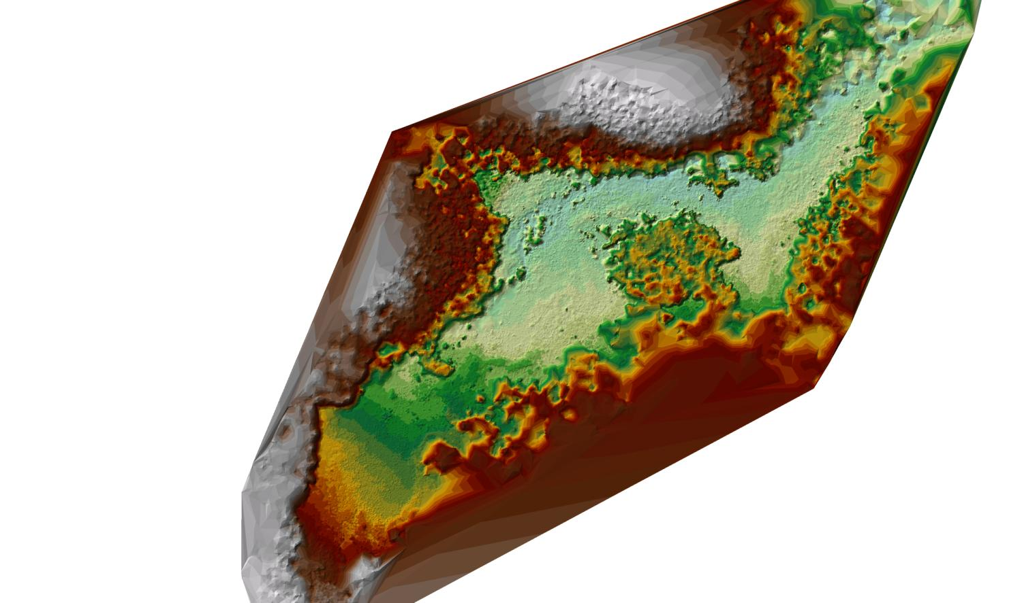
Elevation measurements
Boundary changes, tree growth, tree counts
Growth related to aspect, substrate etc

Slide 29
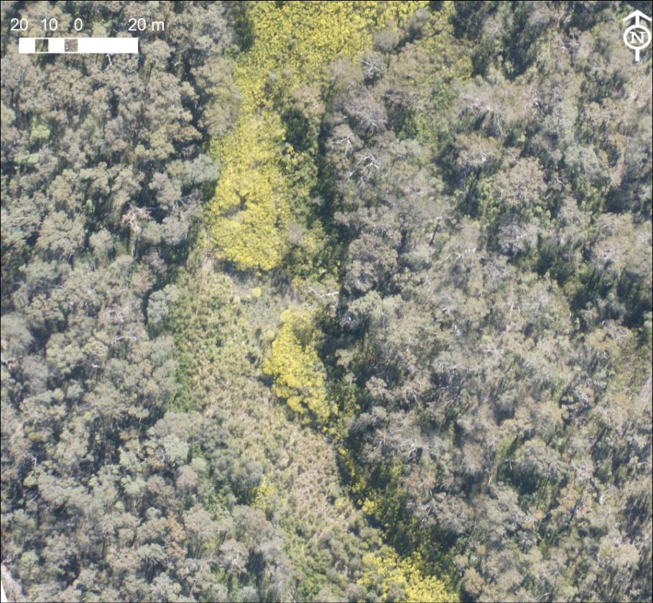
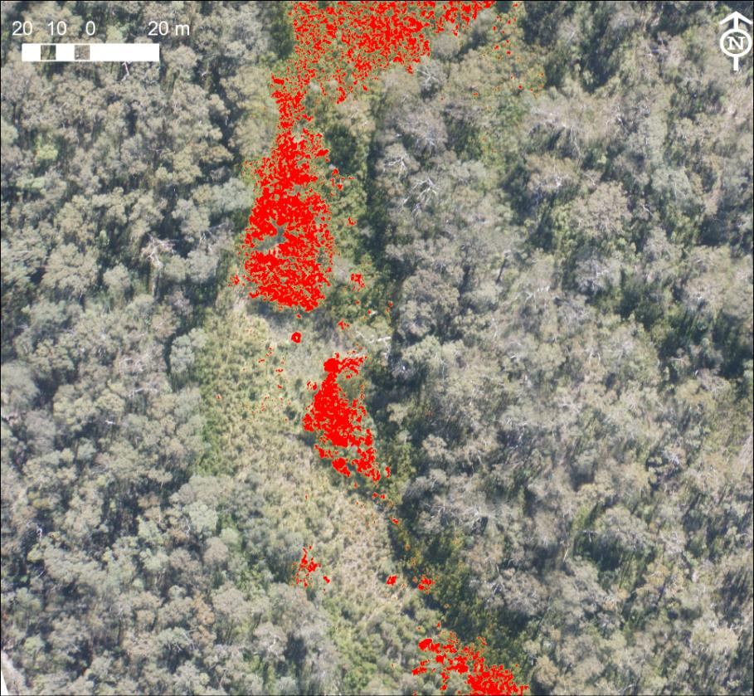
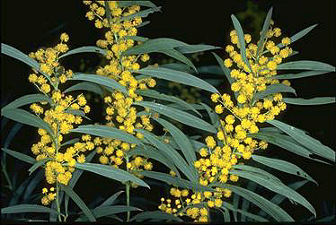
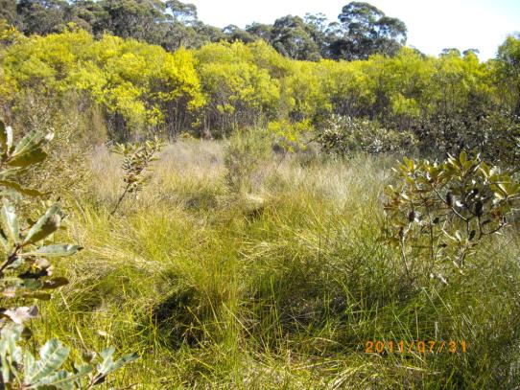
Species Identification using imagery

Slide 30
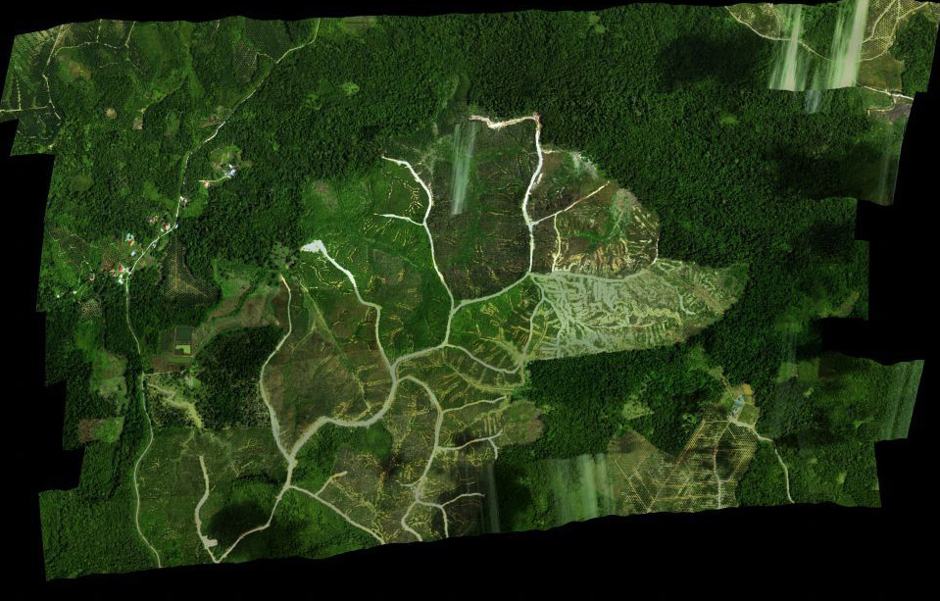
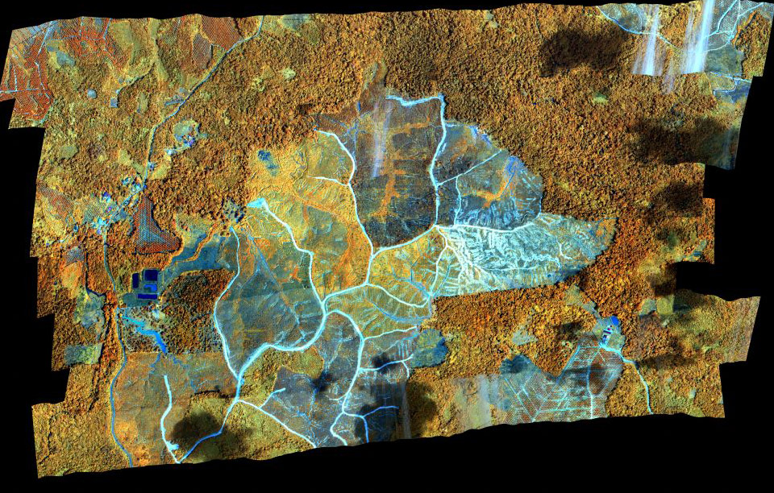
Hyperspectral imagery
Hyperspectral unit (AISA Eaglet) is available in Sabah
205 spectral bands (400-1000nm) at 25cm resolution on the ground

Slide 31
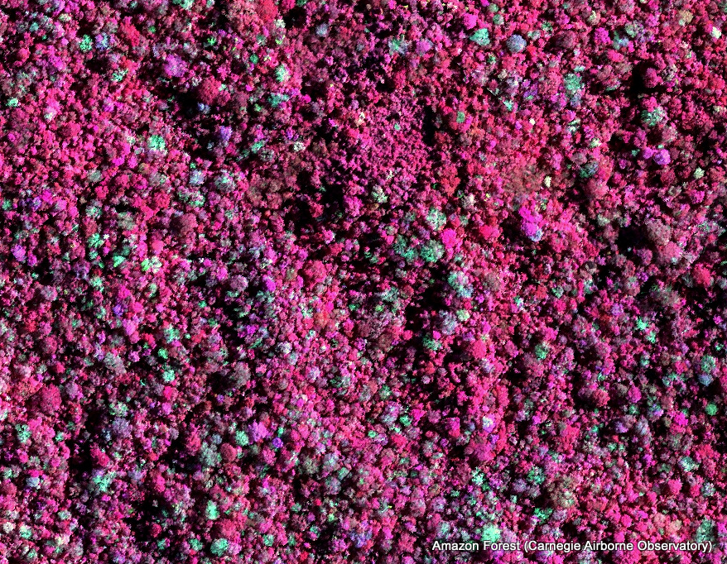
Recognition of individual tree species

Slide 32
Outlook

Slide 33
Broader perspective of Mount Kinabalu case
Mount Kinabalu is the converge point of biogeography in the region and hence scientific questions relating to the evolution and distribution of species has regional relevance.
Large scale lateritic nickel mining threatens ultramafic outcrops in Indonesia and the Philippines. Greater understanding of ultramafic ecosystems might assist in ‘ecosystem restoration’.
Methodologies developed in the Mount Kinabalu case could be used elsewhere in the region.

Slide 34
Questions?

Slide 35
Building a model for Mount Kinabalu
Species attributes and field validation
Image analysis
Spectral + texture: eCognition
Spectral data (e.g. 0.25m hyperspectral imagery)
2D imagery
Species distribution database
PIX4D rendering
Geology and geochemistry database
Digital Surface Model (DSM)
Climate monitoring data
Plant distribution
model
Climate model
Species attributes

